Slide 1
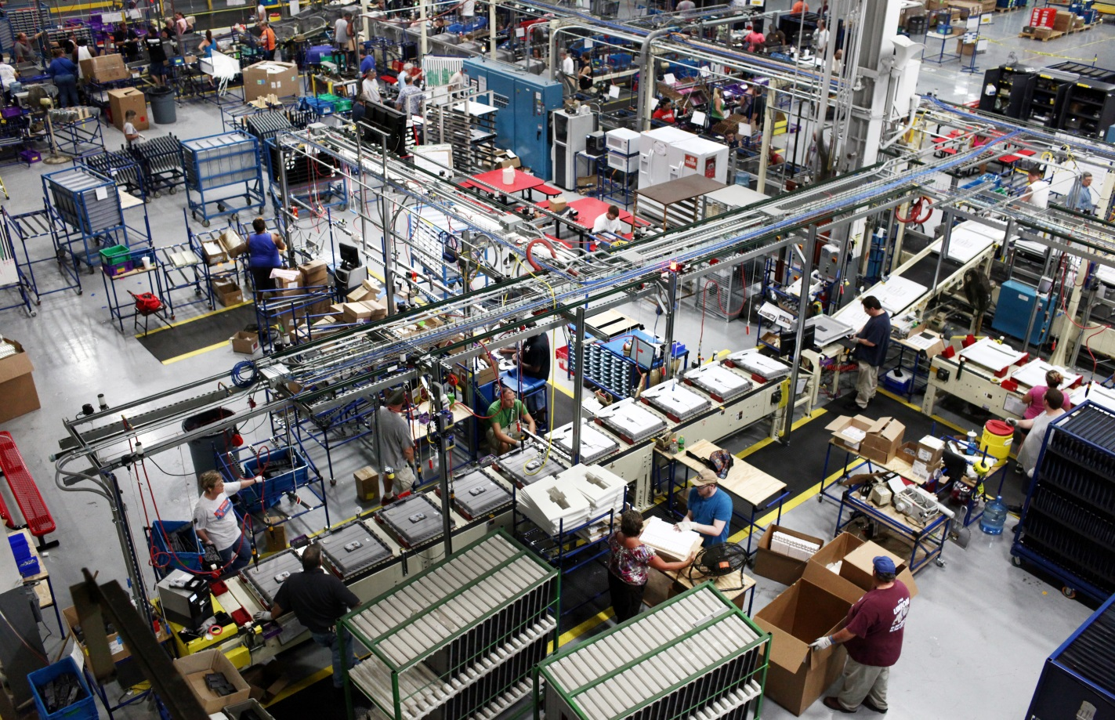

Making of manufacturing driven economy

Slide 2
New Government, new directions for a vibrant economy
3

Slide 3
Our mandate is to put India on a world map as a Manufacturing hub
–
Promoting growth of manufacturing industry & facilitating investment
Framing Foreign Direct Investment (FDI) Policy, facilitating foreign investment & bilateral/multilateral engagements for industry and investment
Administering intellectual property regime consistent with international commitments
Facilitating development of industries through up-gradation of industrial infrastructure
Responsibility as Administrative Ministry for specific industries allocated to the Department, viz cement, paper, boiler, leather, rubber, light engineering, salt and consumer industries
4

Slide 4
Three pillars for bringing out transformation in manufacturing have been defined
–
Improving Business Environment
Ease of Doing Business
De-licensing & Deregulation
Enabling Manufacturing
Industrial Corridors
Industrial Clusters
Nurturing Innovation
Skill Development
Opening up Foreign Direct Investment in key sectors
Opening of critical sectors like Defense, construction and Railways for FDI
Smart Cities
5

Slide 5
Improving Business Environment
–
Process of applying for Industrial License & Industrial Entrepreneur Memorandum made online on 24X7 basis through eBiz portal
Validity of Industrial license extended to three years
States asked to introduce self-certification and 3rd Party certification under Boilers Act
Major components of Defence products’ list excluded from industrial licensing
Dual use items having military as well as civilian applications deregulated
Services of all Central Govt. Departments & Ministries will be integrated with the E-Biz - a single window IT platform for services- by 31 Dec. 2014
6

Slide 6
Improving Business Environment
–
Advisory sent to all Departments/ State Governments to simplify and rationalize regulatory environment:
All returns should be filed on-line through a unified form;
A check-list of required compliances should be placed on Ministry’s/Department’s web portal;
All registers required to be maintained by the business should be replaced with a single electronic register;
No inspection should be undertaken without the approval of the Head of the Department; and
For all non-risk, non-hazardous businesses a system of self-certification should be introduced
7

Slide 7
Enabling manufacturing
–
Impetus on developing Industrial Corridors and Smart Cities
  Delhi-Mumbai Industrial Corridor:
  work on 5 smart cities in progress:
  Dholera, Shendra-Bidkin, Greater Noida , Ujjain and Gurgaon
  Chennai-Bengaluru Industrial Corridor: Master Planning for 3 new Industrial Nodes [Ponneri (TN), Krishnapatnam (AP), Tumkur (Karnataka)] in progress.
Bengaluru – Mumbai Economic Corridor
  A new ‘National Industrial Corridor Development Authority’ being created to coordinate, integrate, monitor and supervise development of all Industrial Corridors.
North-East Corridor Linked to Myanmar & other Industrial Corridors
  Chennai-Vizag Industrial Corridor: Feasibility Study commissioned by ADB.
  Amritsar-Kolkata Industrial Corridor:
  DMICDC selected as Nodal Agency for doing Feasibility Study, which is being conducted at fast pace.
100 days of the New Government •
8

Slide 8
Enabling manufacturing
–
New Industrial Clusters for promoting advance practices in manufacturing
Approval accorded to 21 Industrial projects under Modified Industrial Infrastructure Upgradation Scheme
Use of recycled water through zero liquid discharging systems
With an emphasis on
Central Effluent Treatment plants
Under NMP, one additional National Investment and Manufacturing Zone (NIMZ) at Kalinganagar, Jajpur district in Odisha given in-principle approval, bringing the number to 17
9

Slide 9
Enabling manufacturing
–
Nurturing Innovation
Approval obtained for strengthening Intellectual Property regime in the country through:
Creation of 1033 posts
Further upgradation of IT facilities
Act recognizing National Institute of Design (NID), Ahmedabad, as an institute of National Importance notified on 8th August 2014. This will enable it to confer degrees, promote research and function as an Apex body in Design Education.
4 NIDs being developed
100 days of the New Government •
10

Slide 10
Enabling manufacturing
–
Skilling the youth
Training imparted to 51,216 youth
Impetus given to skill development through Indian Leather Development Programme
For augmentation of training infrastructure, funds released for establishment of 2 new branches of Footwear Design & Development Institute at Banur (Punjab) and Ankleshwar (Gujarat)
11

Slide 11
Opening up Foreign Direct Investment in key sectors
–
Policy in Defence sector liberalised and FDI cap raised from 26% to 49%.
100% FDI under automatic route permitted in construction, operation and maintenance in specified Rail Infrastructure projects
Easing of norms underway for FDI in the Construction Development sector
12

Slide 12

Our collective efforts have started showing results

Slide 13
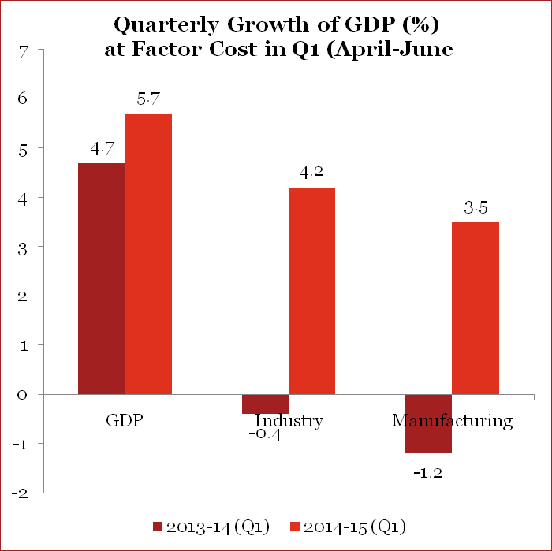
India on a growth path
–
GDP Growth
GDP growth rate improved to 5.7% in the first quarter (April-June) of 2014 compared to 4.7% in first quarter of 2013 Industry GDP growth rate spiked at 4.2% in the first quarter of 2014 compared to -0.4% in the first quarter of 2013. Industry GDP growth rate also spiked to 3.5% in Q1 of 2014 compared to -1.2% in the corresponding Q1 of 2013
Source: DIPP
13

Slide 14
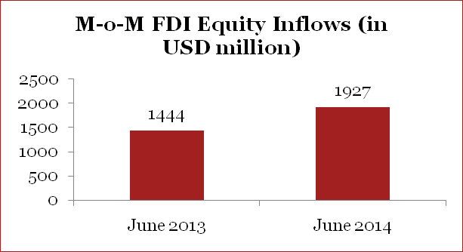
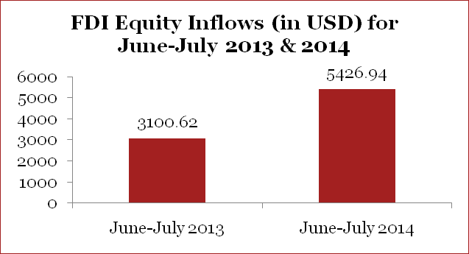
India on a growth path
–
FDI Inflows
M-o-M FDI inflows increased from USD 1.4 bn in June 2013 to USD 1.9 bn in June 2014 recording an increase of 33%.
33%
FDI Inflows
Foreign Direct Investment inflows have increased 75% in the months of June-July 2014 (combined) over the same time period in the preceding year.
75%
Source: DIPP
14

Slide 15
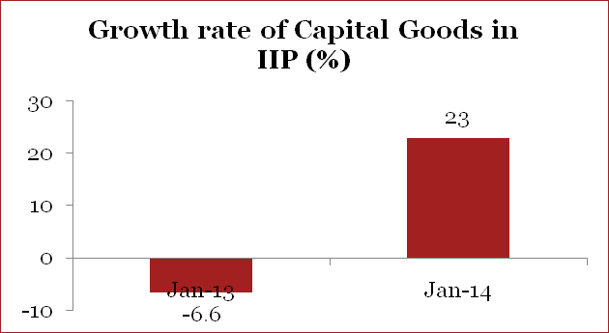
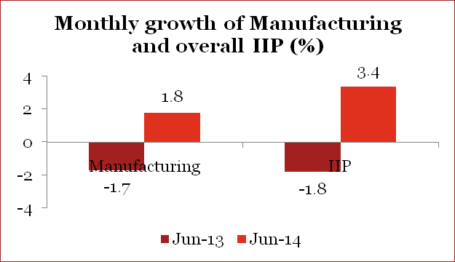
India on a growth path
–
Industrial Growth
The performance of industrial sector as measured by growth of Index of Industrial Production (IIP), has improved in June 2014 as compared to June 2013
Industrial Growth
Performance of Capital goods, which is an indicator of revival of positive investment sentiment has shown considerable improvement in June 2014 as compared to June 2013.
Source: DIPP
15

Slide 16
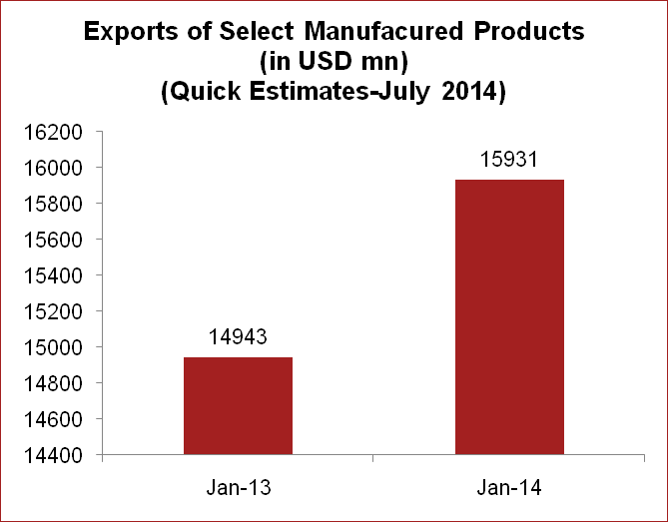
India on a growth path
–
Trade – Manufacturing (Exports Selected Major Commodities)
Most of the manufactured products have witnessed a positive growth in exports in July 2014 as compared to July 2013
Source: DIPP
16

Slide 17
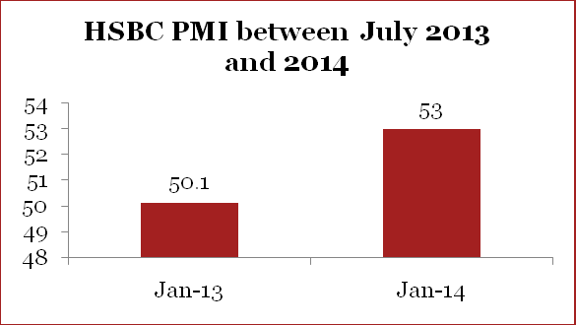
Improving sentiments
–
Manufacturing Purchasing Managers Index (HSBC)
HSBC PMI which gives an overview of business conditions in manufacturing sector was a 17-month high in July 2014 at 53.0
Business Confidence Index (NCAER)
Business Confidence Index rose by 13% in June over April 2014, overshadowing 3.8% increase in April over January, 2014.
Source: DIPP
17

Slide 18
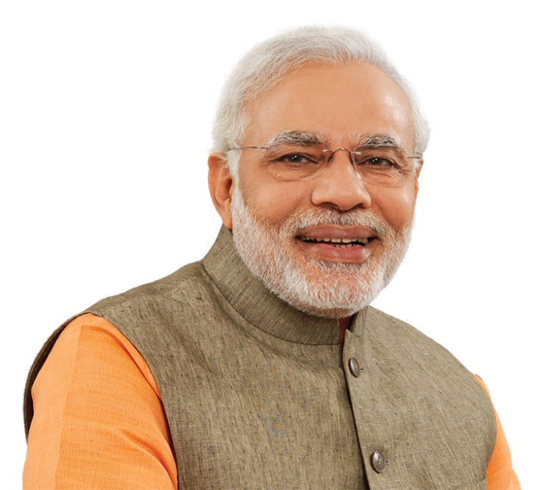
Road Ahead
–
Hon’ble Prime Minister, in his Speech from ramparts of Red Fort on Independence Day on August 15, 2014 has defined future course of action:
“….. I want to appeal all the people world over…. ...Come, Make In India. Sell anywhere but manufacture here…...”
“We should manufacture goods in such a way that they carry zero defect, that our exported goods are never returned to us. We should manufacture goods with zero effect that they should not have a negative impact on the environment.”
18

