Slide 1
India - Japan
Business Unit
A winning partnership
India : The Investment Destination
1

Slide 2
New Government, new directions for a vibrant economy
2

Slide 3
India is one of the fastest developing economies in the world and ranks among the most sought after investment destinations
–
Top 10 prospective host economies for 2014-16
3rd largest economy in terms of purchasing power¹
The 9th Global Capital Confidence Barometer, October 2013, has reported India among one of the top five investment destination among emerging and developed markets²
India accounts for 5.5% of global FDI in terms of value and 6.3% in terms of projects²
India is the fourth most attractive location for FDI for 2014-2016 as per UNCTAD Report 2014
India ranks 2nd Most Promising Country for Overseas Business Operations in the Medium Term⁴;
India has been rated as Top Investment Destination for the Long Term⁵
Source: UNCTAD, World Investment Report 2014
3

Slide 4
Increase in foreign investments and industrial growth during the May-July period shows the restored confidence in the economy and the new government
–
FDI inflows have increased 80% in the months of May-June 2014 (combined) over the same time period in the preceding year
M-o-M FDI equity inflows have increased 33% in June 2014 compared to June 2013
Overall Index of Industrial Production (IIP) has grown by 3.4% in June 2014 as compared to 1.8% in June 2013
Growth rate of Capital goods in IIP has shot up from -6.6% in June 2013 to +23% in June 2014
Purchasing Managers Index (PMI) as on 1st August 2014 was at 17-month high
Manufactured exports have recorded 6.6% growth in July 2014 as compared to July 2013
33%
4
Source: DIPP

Slide 5
Strategic opportunities
5

Slide 6
The new Government has prepared a five pillar strategy to drive India’s growth, which offer multiple avenues of collaboration and investments
–
Infrastructure development
Manufacturing growth, Employment creation and promoting entrepreneurship
Energy sufficiency
Business environment improvement
Skill development
6

Slide 7
Government is focused on improving both the industrial infrastructure as well as the urban infrastructure of the country and has announced several high impact projects in the sector
–
Industrial infrastructure
Industrial corridors
Delhi Mumbai Industrial Corridor (DMIC)
Chennai Bengaluru Industrial Corridor (CBIC)
Vizag Chennai Industrial Corridor (VCIC) as first phase of East Coast Economic Corridor (ECEC)
Bengaluru Mumbai Economic Corridor (BMEC)
Amritsar – Kolkata Industrial Corridor (AKIC)
Transport connectivity to North East India
Urban infrastructure
Smart Cities
Affordable housing
Swachha Bharat project
Digital India
7

Slide 8
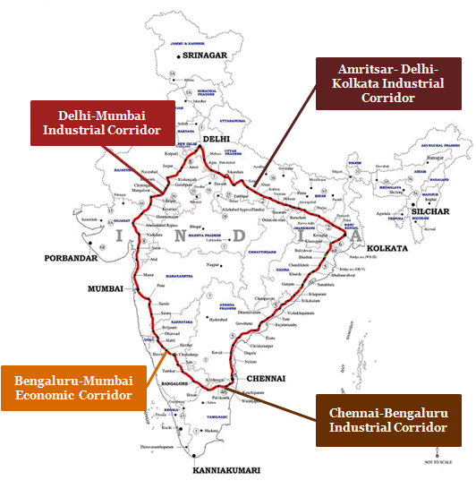
The upcoming industrial corridors provide potential opportunities for investments across different infrastructure sub-sectors
–
To promote manufacturing in India, five new Industrial Corridors are being planned.
Each Industrial Corridor will have at least 6 – 8 key nodes developed on Smart City principles measuring more than 200 sq. Km
DMICDC is the apex authority that is planning these corridors.
East Coast Industrial Corridor
8

Slide 9
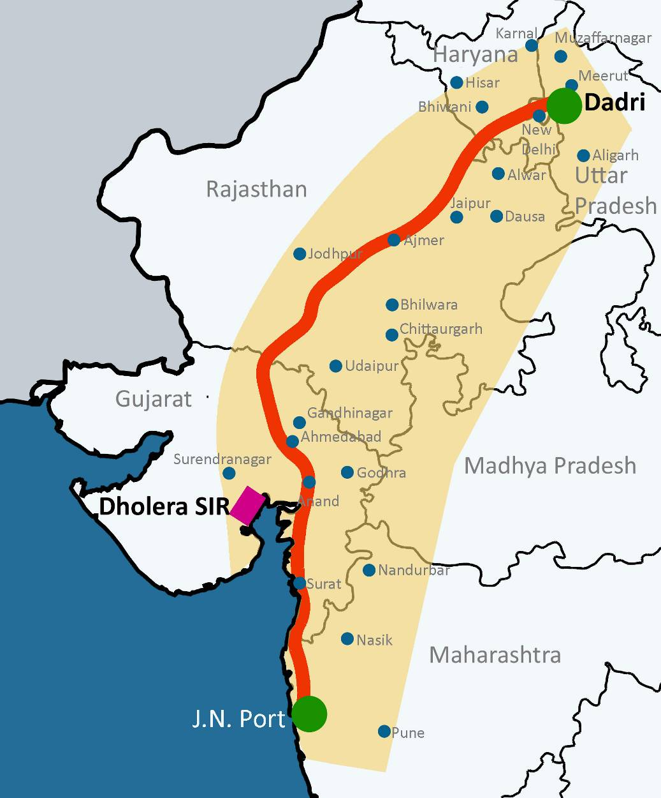
DMIC is being developed as a flagship project of partnership & collaboration with Government of Japan and offers several opportunities for investors
–
Nodes | Area (sq km)
Ahmedabad Dholera Investment Region | 920
Manesar-Bawal Investment Region, Haryana | 402
Khushkhera-Bhiwadi-Neemrana Investment Region, Rajasthan | 165
Pithampur-Dhar-Mhow Investment Region, M. P. | 372
Dadri-Noida-Ghaziabad Investment Region, U.P. | 200
Dighi Port Industrial Area, Maharashtra | 253
Shendra Bidkin Industrial Park, Maharashtra | 84
Key early bird projects | Budgetary Support by GoI (Rs mn.)
Vikram Udyogpuri, near Ujjain, Madhya Pradesh | 595
Integrated Industrial Township at Greater Noida, UP | 6,172
Water Supply Project, Madhya Pradesh | 704
Construction of New Rail Line between Bhimnath and Dholera SIR, Gujarat | 243
Logistic Data Bank | 372
Model Solar Power Project, Neemrana, Rajasthan | 353
GoI is developing DMIC as a global manufacturing and investment destination utilizing the 1,483 km-long, high-capacity western Dedicated Railway Freight Corridor (DFC) as the backbone.
9

Slide 10
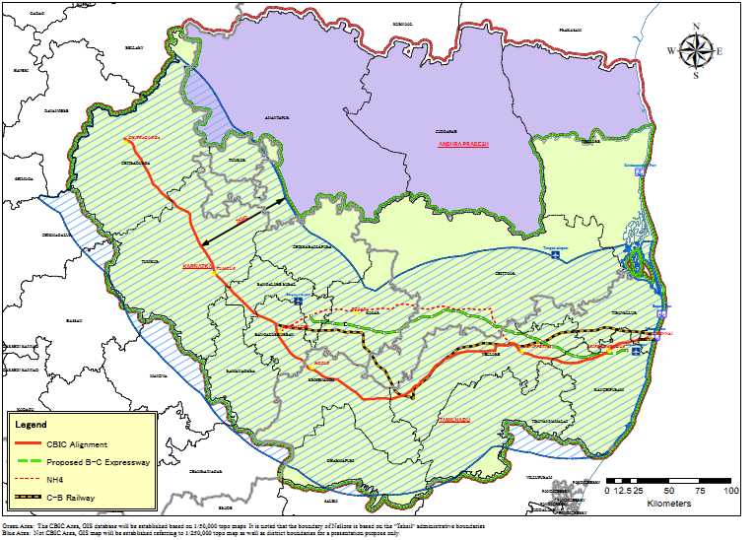
CBIC is the second corridor project under Japanese Government partnership; aimed at improving the industrial infrastructure and increasing investments across multiple sectors in the region
–
Key nodes identified | State
Bidadi Township Area, Ramanagara | KAR
Vasanthnarasapura area in Tumkur | KAR
Mulbagal in Kolkar | KAR
Ponneri Industrial Area | TN
Hosur Industrial Area | TN
Hindupur Industrial Area | AP
Chittoor NIMZ | AP
Krishnapatnam Industrial Area | AP
The corridor between Chennai – Bengaluru – Chitradurga (around 560 km) would have an Influence Area spread across the states of Karnataka, Andhra Pradesh and Tamil Nadu.
10

Slide 11
The Vizag Chennai Industrial Corridor is a part of the East Coast Economic Corridor, aligned to the Golden Quadrilateral and is envisaged to play a key role in India’s Look East Policy
–
1.Visakhapatnam
Key attributes of the corridor
The Corridor contributes to 5% of national GDP Influence area of the corridor is over 110,000 sq. km which is 3.5% of India’s area Industrialization will be supplemented by natural resources available in the region (natural gas, minerals, agriculture products). The major ports are well connected and in close proximity to many of the East Asian economies (~80% of AP’s coastline)
2. East Godavari
1
3.West Godavari
2
4. Krishna
3
5. Guntur
4
5
6. Prakasam
6
8. Kadapa
Successor state of AP*
8
7
7.Nellore
Tamil Nadu
NH 5 alignment
9.Chittoor
9
10
10.Tiruvallur
11
11.Chennai
The corridor between Vizag - Chennai (around 800 km) would have an Influence Area spread across the states of Andhra Pradesh and Tamil Nadu.
In view of the commitment made by the central government under the Andhra Pradesh Reorganisation Act, 2014, in the first phase of the study the ADB will focus on the Vizag-Chennai Section so that a final view on the Vizag-Chennai Industrial Corridor may be taken within the timeline prescribed in the Act and further action taken accordingly.
11

Slide 12
GoI has announced 100 Smart City projects across 21 states with a view to provide a fillip to the urban infrastructure in the country GoI has announced 100 Smart City projects across 21 states with a view to provide a fillip to the urban infrastructure in the country
The Government has allocated Rs. 70.60 billion in the General Budget to develop the 100 Smart Cities in the country.
To encourage development of smart cities, with respect to FDI in the construction development sector, the condition for built up area reduced from 50,000 sq. m to 20,000 sq. m and minimum capitalisation norms reduced from USD 10 million to USD 5 million, with three years lock-in.
12

Slide 13
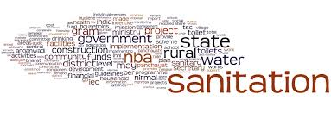
GoI is also focused around other urban infrastructure aspects of Affordable housing and Sanitation, and has set definitive goals in these areas
–
The Government has announced to set up a Mission on Low Cost Affordable Housing anchored in the National Housing Bank (NHB).
A sum of Rs. 4,000 crore for NHB is provided with a view to increase the flow of cheaper credit for affordable housing
Projects which commit at least 30% of total project cost for low cost affordable housing to be exempted from the built-up and capitalization conditions
Source: GoI General Budget, 2014-15
The Government intends to cover every household by total sanitation by the year 2019, the 150th year of the Birth anniversary of Mahatma Gandhi through Swatchh Bharat Abhiyan.
Source: GoI General Budget, 2014-15
13

Slide 14
Government is committed to promote manufacturing and employment. The NMP lays the foundation for larger contribution of manufacturing sector in GDP
–
Objectives of National Manufacturing Policy (NMP):
To promote investments in the manufacturing sector and make the India a hub for both domestic and international markets
To increase the sectoral share of manufacturing in GDP to 25% by 2022 (from about 15% presently)
To double the current employment level in the manufacturing sector
To enhance global competitiveness of India’s manufacturing sector
NMP proposes setting up of National Investment and Manufacturing Zones (NIMZs), which would be much larger than SEZs in area (can be viewed as a cluster of smaller industrial areas . SEZs, EoUs etc.)
Sectors of Strategic Importance
Defence Equipment
Aerospace
Sectors of Basic Inputs
Steel
Sectors for Depth and Value Addition
Ship-building & Repair
Capital Goods & Engineering
Mineral Exploration and Development
Fertilizer
Cement
Automotive
Electronics
Drugs & Pharma
Chemical
Petrochemicals
Paper
Sectors for Employment Generation
Textlies
Food Processing
Leather & Leather Goods
Gems and Jewellery
Source: NMP 2011
14

Slide 15
India has the potential to offer myriad of opportunities for foreign investors across a wide gamut of manufacturing sectors (1)
–
 | Auto | Auto components | Defence
Overview | Likely to become 3rd largest auto market in the world by 2016, accounting for more than 5% of the global vehicle sales India’s is 2nd largest two wheeler manufacturer, largest motor cycle manufacturer and 5th largest commercial vehicle manufacturer Expected size by 2016 is USD 145 billion. | Worth USD 39.7 billion in FY2012–13 India’s exports of auto components increased at a CAGR of 17% during 2008-13; Exports have risen to USD 9.7 billion in 2012-13 | 3rd largest armed forces in the world. Largest importer of conventional defence equipment 70% of defence requirements are met through imports Defence budget in 2014-15 is USD 38 billion, expected to reach USD 50 billion by 2018
Investment opportunities | Passenger Vehicles Two Wheelers Three Wheelers Commercial Vehicles low cost electric vehicles | Engine & Engine Parts Transmission & Steering Parts Suspension & Breaking Parts Electrical parts | Manufacturing of defence equipment Maintenance, repair and overhaul segment Engineering services outsourcing
FDI policy | 100% FDI is allowed under the automatic route | 100% FDI is allowed under the automatic route | Up to 49% under the government route and beyond 49% through CCS (in case of transfer of technology)
15

Slide 16
Opportunities
–
 | Electrical Equipments | ESDM | Pharmaceutical
Overview | Estimated output by 2022 approx. USD 100 billion The market expanded at a CAGR of 10.5 per cent over (FY07–12). | Worth USD 68.31 billion in 2012; anticipated to be USD 94.2 billion by 2015; CAGR of 9.88% between 2011 and 2015 | Accounts for about 2.4 % of the global pharma industry in value terms and 10% in volume terms Expected to grow at 12.1% during 2012–20 Expected to reach USD250 billion by 2020 from the current USD65 billion
Investment opportunities | Generation Machinery: Boilers, Turbines, Generators Transmission Machinery | Consumer electronics Strategic electronics Medical electronics Avionics Fabless manufacturing Automotive electronics Electronic Manufacturing Services EMCs | Active pharmaceutical ingredients (APIs) Contract research and manufacturing services (CRAMS) Formulations
FDI policy | 100% FDI is allowed under the automatic route subject to all the applicable regulations and laws. | 100% FDI through automatic route for ESDM except for defence electronics | 100% FDI is allowed under the automatic route for Greenfield projects. For brownfield project investment up to 100% is under the government route.
16

Slide 17
Opportunities
 | Construction | Food Processing | Leather
Overview | Second largest employer and contributor to economic activity, after agriculture sector. Accounts for 2nd highest FDI inflow after the services sector Worth USD 78.5 billion in FY13; expected to grow to USD 140 billion in FY17. | Industry size is Rs 845 billion in 2012-13, growing at 8.4% for the last five years ending 2012-13 Value addition of sector as share of GDP manufacturing was 9.8% in 2012-13 | Industry size approx. USD 11 billion (exports - USD 6 billion and domestic market - USD 5 billion) Exports projected to grow at 24% pa in next five years. Domestic market expected to double in next five years.
Investment opportunities | Residential, retail, commercial and hospitality sectors Technologies and solutions for sustainable cities, low cost and affordable housing, Green building solutions, environment friendly building materials Training and skill development of construction sector workers Smart cities Urban water supply; urban sewerage & sewage treatment | Fruits and Vegetables Fermentation products Beverages Dairy Food additives, nutraceuticals Confectionary and bakery Meat & poultry Fish and sea foods processing Grain Processing Food packaging Food processing equipment Consumer food | Tanning and finishing of leather products Manufacturing of leather garments Manufacturing of leather footwear and footwear parts Manufacturing of leather goods, such as harness and saddlery.
FDI Policy | 100% FDI is allowed under the automatic route subject to conditions. | 100% FDI through automatic route for most of the food products except for items reserved for MSME. | 100% FDI is allowed under the automatic route subject to all the applicable regulations and laws.
–
17

Slide 18
Opportunities
 | Chemicals Petrochemicals | Oil & Gas | Textile
Overview | Size of the industry (2012-13) is around USD 144 billion India accounts for approximately 16% of the world production of dyestuff and dye intermediated The polymer demand is expected to grow by 8-10% with a healthy growth in clothing, automobiles, etc. | 4th largest consumer of crude oil and petroleum products in the world (2013) Oil imports constitute 80% of India’s total domestic oil consumption (May 2014). At the end of 2013, India had 215.066 MMTPA of refining capacity, making it the second-largest refiner of crude oil in Asia. | 2nd largest textile manufacturing capacity globally Sector contributes 14% to industrial production and 4% to GDP and 13% of country’s export earnings Domestic textile and apparel industry is estimated to reach USD 100 bn by 2017 from USD67 bn in 2014. Exports are expected to increase to USD 65 bn by 2017 from USD 40 bn in 2014
Investment opportunities | Petrochemicals Specialty chemicals Agrochemicals Colorants Technical training | Underground coal gassification E&P services and equipments City gas distribution Refinery Technology partnerships in upstream sector | Entire value chain of Synthetics Values added and speciality fabrics Technical Textiles Garment Retail Brands
FDI policy | 100% FDI is allowed under the automatic route subject to all the applicable regulations and laws. | FDI is subject to the existing sectoral policy and regulatory framework and varies across the value chain | 100% FDI is allowed under the automatic route in textile sector
–
18

Slide 19
Energy Sufficiency through Thermal Power and Renewable Power is high on Government’s agenda
–
Fifth largest producer and consumer globally
With a production of 1,006 TWh, India is the fifth largest producer and consumer of electricity in the world
Power generation and installed capacity has grown rapidly over the years
Over FY07–13, electricity production expanded at a CAGR of 5.5%
Installed capacity increased steadily over the years, posting a CAGR of 10.9 per cent in FY09–13
Strong policy support to further incentivize power sector
Policies such as Electricity Act, 2003, National Tariff Policy, 2006, Ultra Mega Power Projects (UMPPs), R-APDRP and fuel supply agreement are aiding growth of the sector
The energy sector is one of the most developed and organised sectors in India
19
Source: Ministry of Power; Council of Power Utilities; Bureau of Energy Efficiency; India Brand Equity Foundation

Slide 20
The energy sector is full of varied opportunities in the thermal and renewable energy sector
–
Growing demand
Expansion in industrial activity to boost demand for electricity
Growing population and increasing penetration and per-capita usage to provide further impetus
Power consumption is estimated to increase from 821.2 TWh in 2013 to an estimated 1433.2 TWh in 2022
Attractive opportunities
Large capacity additions (189GW) targeted in the 12th and 13th Five-Year Plans
Ambitious projects and increasing investments across the value chain
Diversification into renewable sources increasing growth avenues
Advantage India
Higher Investments
FDI inflows touched USD7.8 billion between April 2000-March 2013
Major investments earmarked by public as well as private sector companies across the value chain
Policy Support
Elimination of Licensing for various segments; removal of entry barriers
Cost reduction and rationalization of tariffs; development of UMPP
Fuel supply agreement of power producers with Coal India
20
Source: Ministry of Power; Ministry of New and Renewable Energy; India Brand Equity Foundation

Slide 21
The new Government has proactively taken multiple steps to bring about process improvements….
–
Process improvement initiatives
Process of applying for IL/IEM made completely online and 24X7
ESIC/EPFO registration made on-line and real time, need for submission of hard copies removed
States advised to introduce self certification and third party inspection for the Boilers Act
All security clearances will be given by MHA within 3 months.
Need for affidavit from entrepreneur obviated with issue of ‘Security Manual for Licensed Defence Industry’
Requirement of License on a number of Defence List products removed
Validity of Industrial License extended from 2 years to 3 years.
Questionnaires on ‘Enforcing Contract’ and ‘Resolving Insolvency’ filled by Government of first time.
Advisory sent to Ministries/State Governments:
All returns to be made online
Check list of all compliances to be put on web-site
All registers to be replaced with one single electronic register
No inspection without approval from Head of the Department
Self-certification for non-hazardous/non-risk businesses
21

Slide 22
….and labour & sector related initiatives to improve the overall “Ease of doing business” in India
–
Labour related initiatives
Unified Single Web Portal for Labour Law Compliance
Initiated amendment of Factories Act, 1948 to allow for:
Night shift for women
Increased hours of overtime
Compounding of Offences
Rationalization of Returns and Register requirements
Initiated amendment of Apprentices Act, 1961 to increase the percentage of workforce as apprentice and restrict inspections
Single labour law for MSME to be introduced in December, 2014
Evidence based inspections through Central Analysis and Intelligence Unit
Sector specific initiatives
Defence sector
Raised FDI limit in the Defence sector to 49%
Railways sector
Allowed 100% FDI in railway infrastructure sector, in areas such as high-speed train systems, sub-urban corridors and dedicated freight line projects implemented in PPP mode
22

Slide 23
eBiz Mission will transform e-governance beyond online transactions to delivering services to investors and businesses
–
Offers a Single Window for businesses and investors and transparency in processing of requests
Entrepreneurs to submit one integrated application for multiple licenses
Single consolidated payment for the various licenses required by entrepreneurs
Reduction in the number of procedures and correspondingly the cost and time taken for obtaining approvals
24 X 7Facility for Information and Services for businesses
Eventually it will offer coverage of Entire Business Life Cycle
Source: DIPP
23

Slide 24
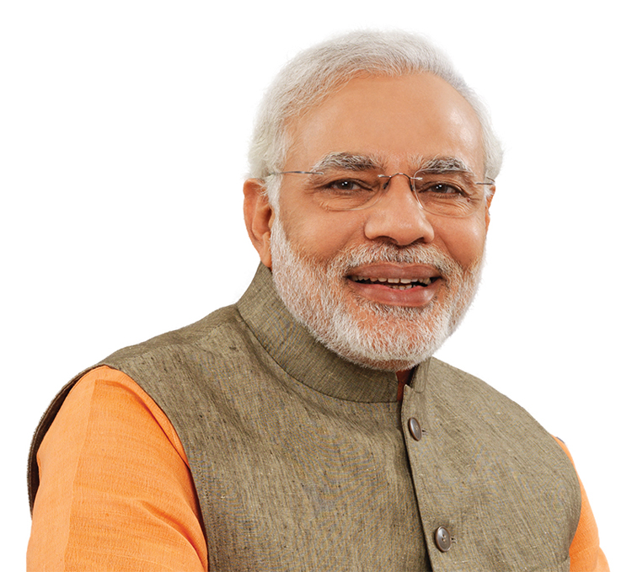
Thank you
–
I invite you to
“Make in India”
24

